Slide 1

Monte Carlo模拟
第四章 Monte Carlo积分

Slide 2
第四章 Monte Carlo积分
Monte Carlo法的重要应用领域之一：计算积分和多重积分
适用于求解：
被积函数、积分边界复杂，难以用解析方法或一般的数值方法求解；
被积函数的具体形式未知，只知道由模拟返回的函数值。
本章内容：
用Monte Carlo法求定积分的几种方法：
均匀投点法、期望值估计法、重要抽样法、半解析法、…

Slide 3
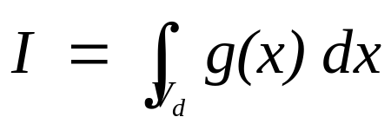
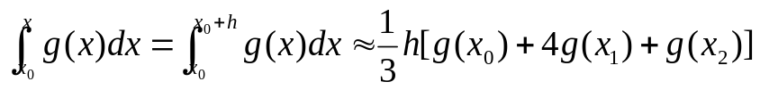

第四章 Monte Carlo积分
目的：计算一个定积分（一维或多维）
数值方法：
将积分区间分成n个子区间，用一些近似的方法计算各个子区间的积分值，然后对n个子区间的积分值求和
梯形法(trapezoidal rule)：对每个子区间用梯形近似
Simpson’s rule：approximating the integral of a function g using quadratic polynomials

Slide 4
第四章 Monte Carlo积分
数值方法存在的问题:
计算速度慢、精度低：
需计算的函数值的数目随着积分维数急剧增长
积分维数d=10, 各方向分点数目n=50, 需计算函数值的数目：~n^{d} = 50¹⁰
不恰当的子区间划分将导致不能很好地近似表示被积函数g(x)➔导致计算误差

Slide 5
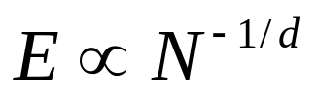
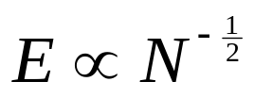

第四章 Monte Carlo积分
Monte Carlo方法可用于计算任何的d重积分
两种方法计算 d-重积分的误差比较
Simpson’s rule,…
Monte Carlo method
purely statistical,
not rely on the dimension !
Monte Carlo method WINS, when d >> 3

Slide 6
Monte Carlo模拟
第四章 Monte Carlo积分
Hit-or-Miss Method
Sample Mean Method
Variance Reduction: Importance Sampling Method
Correlation methods for variance reduction

Slide 7
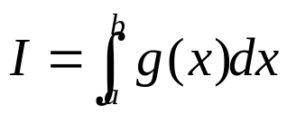

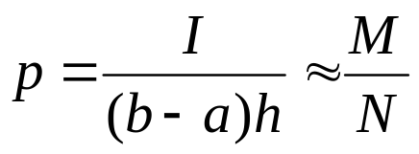
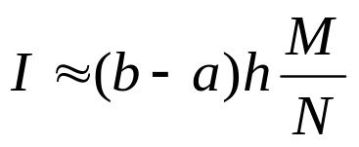
1. Hit-or-Miss Method
Evaluation of a definite integral
h
X
X
X
X
X
X
Probability that a random point reside inside the area
O
O
O
O
O
O
O
a
b
N : Total number of points
M : points that reside inside the region

Slide 8
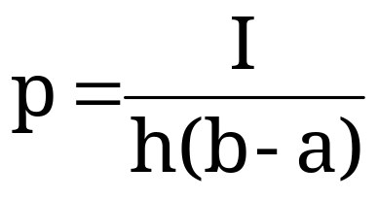
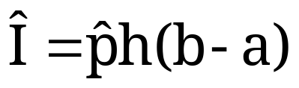

1. Hit-or-Miss Method
Sample uniformly from the rectangular region
[a,b]x[0,h]
The probability that we are below the curve is
So, if we can estimate p, we can estimate I:
where is our estimate of p

Slide 9
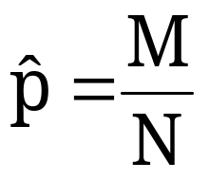
1. Hit-or-Miss Method
We can easily estimate p:
throw N “uniform darts” at the rectangle
let M be the number of times you end up under the curve y=g(x)
let

Slide 10


1. Hit-or-Miss Method
Start
Set N : large integer
M = 0
h
X
X
X
X
X
Loop
N times
Choose a point x in [a,b]
X
O
O
O
Choose a point y in [0,h]
O
O
O
O
a
b
if [x,y] reside inside then M = M+1
I = (b-a) h (M/N)
End

Slide 11
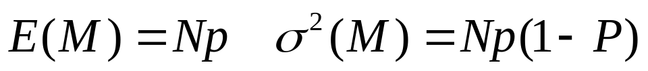
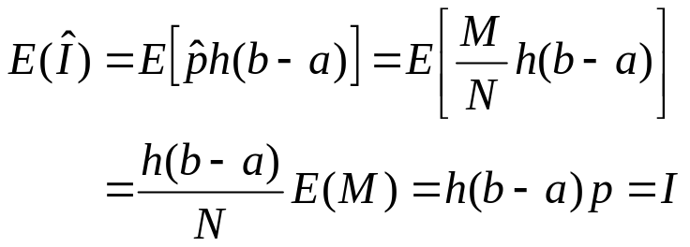
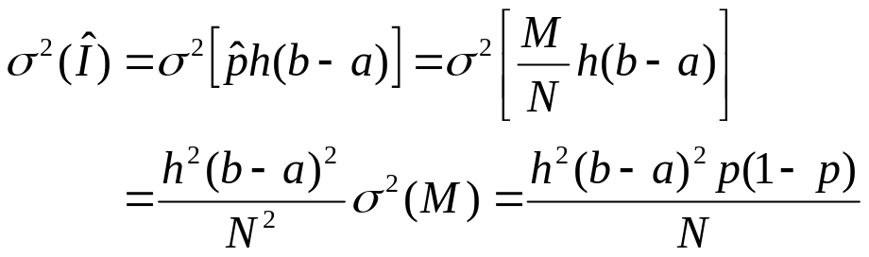
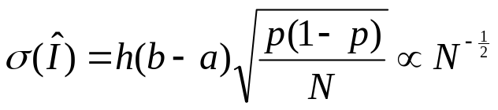
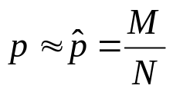
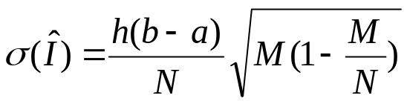
1. Hit-or-Miss Method
Error Analysis of the Hit-or-Miss Method
It is important to know how accurate the result of simulations are
note that M is binomial(M,p)

Slide 12
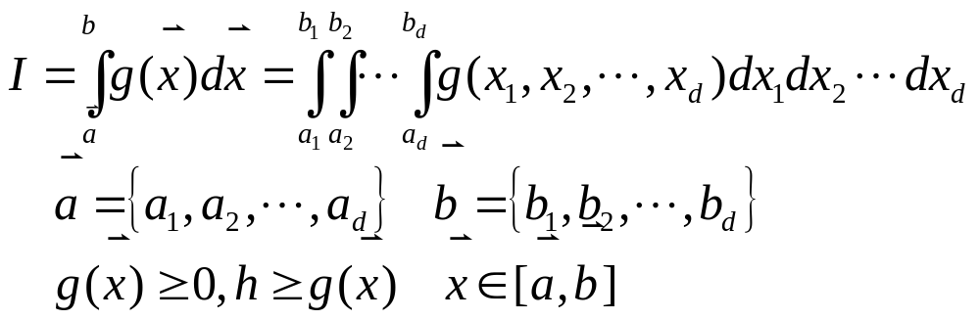
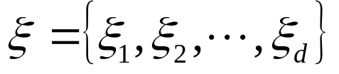


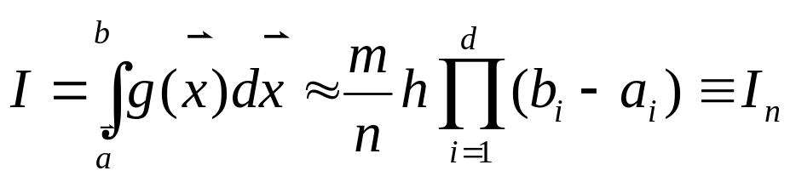
1. Hit-or-Miss Method
推广到多重积分：
区间
内均匀分布的随机数
η=hr : 区间[0,h]内均匀分布的随机数
选取n组
，若其中满足g(ξ)>η的共有m组

Slide 13
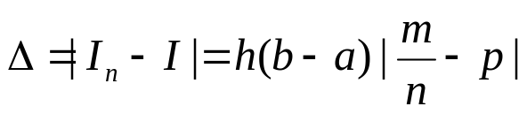
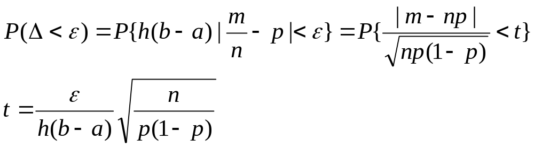
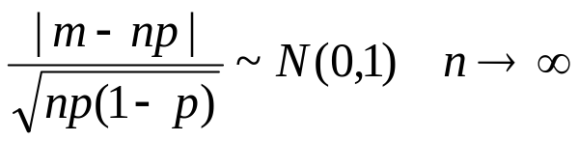
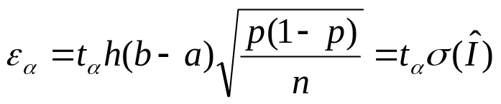
1. Hit-or-Miss Method
积分结果的置信水平：
对于任意给定的正数ε，怎样才能保证积分计算值I_{n}与真值I之差的绝对值Δ小于ε的概率大于α(0< α<1)
根据中心极限定理

Slide 14
Monte Carlo模拟
第四章 Monte Carlo积分
Hit-or-Miss Method
Sample Mean Method
Variance Reduction: Importance Sampling Method
Correlation methods for variance reduction

Slide 15
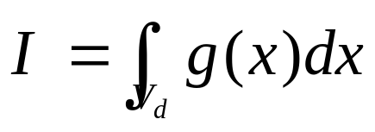
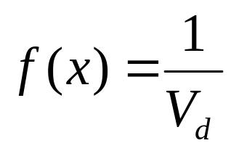
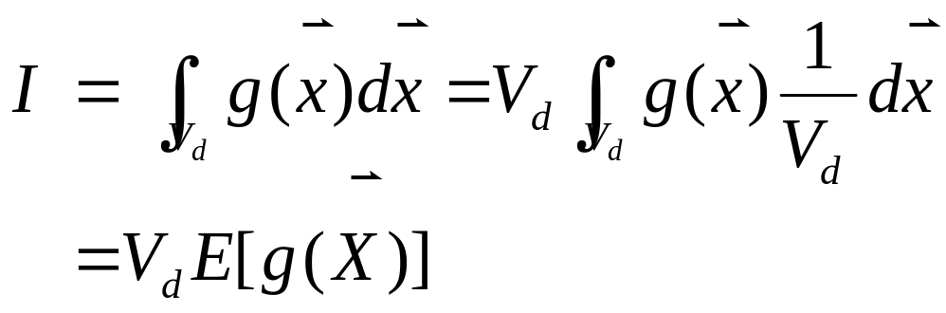
2. Sample Mean Method
设欲求的d-重积分为
令X 为积分域V_{d}上均匀分布的随机向量，其概率密度函数为：

Slide 16
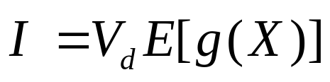
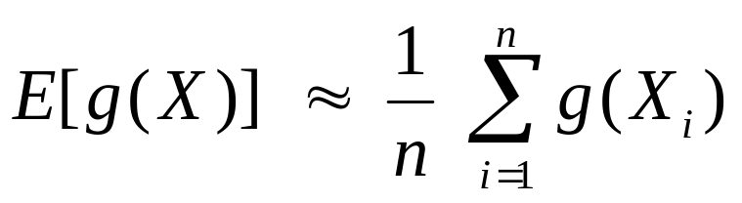
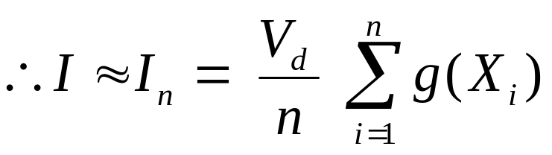
2. Sample Mean Method
X 在积分域V_{d}上均匀分布
产生容量为n的X的随机样本X_{i},并计算g(X_{i}),则根据大数定理，当n足够大时

Slide 17
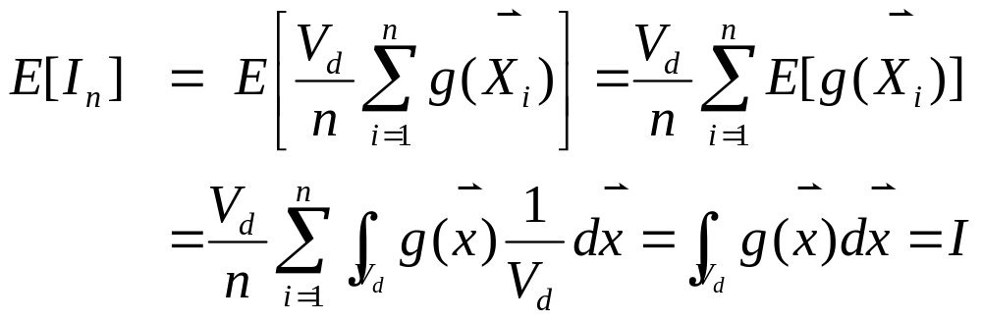
2. Sample Mean Method
误差分析：
This estimator is “unbiased”:

Slide 18
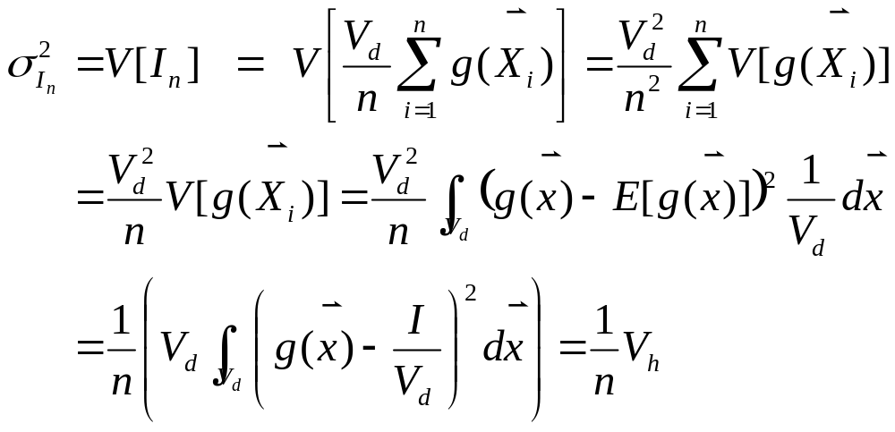
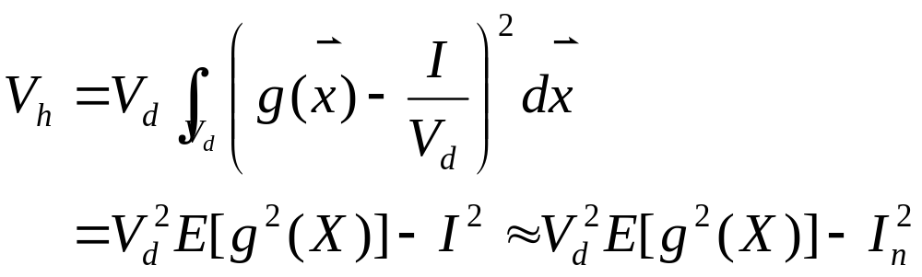
2. Sample Mean Method
Variance of this estimator:

Slide 19
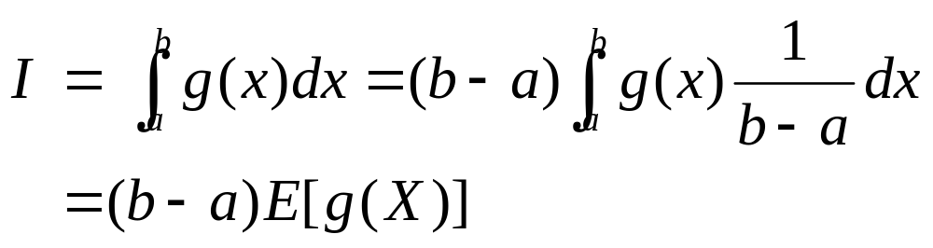
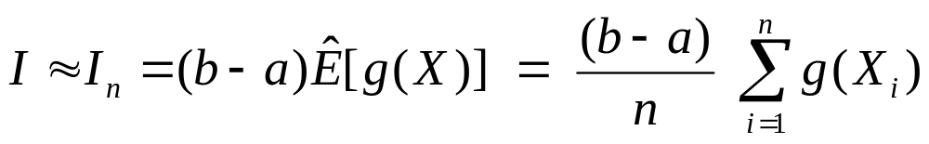
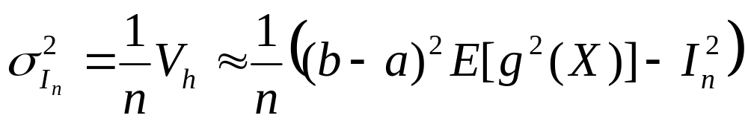
2. Sample Mean Method
一维积分的情况：

Slide 20
2. Sample Mean Method
Start
Set N : large integer
s = 0
Loop
N times
x_{n} = (b-a) u_{n} + a
y_{n} = g(x_{n})
s = s + y_{n}
Estimate mean I_{n}=s/N
End

Slide 21
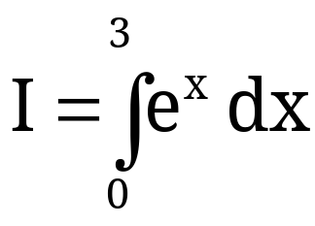
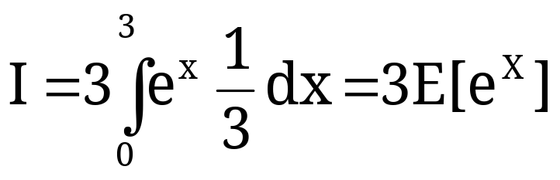
2. Sample Mean Method
Example:
(we know that the answer is e³-1 19.08554)
write this as
where X~unif(0,3)

Slide 22
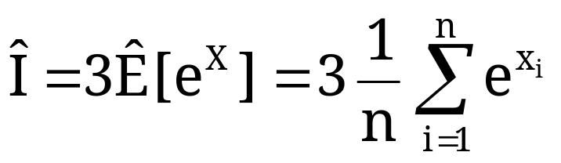
2. Sample Mean Method
write this as
where X~unif(0,3)
estimate this with
where X₁, X₂, …, X_{n} are n independent unif(0,3)’s.

Slide 23

2. Sample Mean Method
Simulation Results: true = 19.08554, n=100,000
Simulation
1 19.10724
2 19.08260
3 18.97227
4 19.06814
5 19.13261

Slide 24


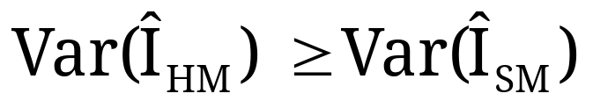
2. Sample Mean Method
Comparison of Hit-and-Miss and Sample Mean Monte Carlo
Let be the hit-and-miss estimator of I
Let be the sample mean estimator of I
Then

Slide 25
2. Sample Mean Method
Comparison of Hit-and-Miss and Sample Mean Monte Carlo
Sample mean Monte Carlo is generally preferred over Hit-and-Miss Monte Carlo because:
the estimator from SMMC has lower variance
SMMC does not require a non-negative integrand (or adjustments)
H&M MC requires that you be able to put g(x) in a “box”, so you need to figure out the max value of g(x) over [a,b] and you need to be integrating over a finite integral.

Slide 26
Monte Carlo模拟
第四章 Monte Carlo积分
Hit-or-Miss Method
Sample Mean Method
Variance Reduction: Importance Sampling Method
Correlation methods for variance reduction

Slide 27
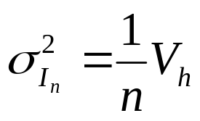
3. Variance reduction: Importance Sampling Method
Sample mean method:
减小积分误差的方法：
增大抽样的次数n；
减小方差V_{h}

Slide 28
3. Variance reduction: Importance Sampling Method
Reducing error
*100 samples reduces the error order of 10
Reducing variance → Variance Reduction Technique
The value of variance is closely related to how samples are taken
Unbiased sampling
Biased sampling
More points are taken in important parts of the population

Slide 29
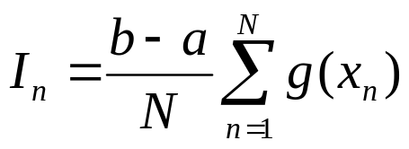

3. Variance reduction: Importance Sampling Method
If we are using sample-mean Monte Carlo Method
Variance depends very much on the behavior of g(x)
g(x) varies little → variance is small
g(x) = const → variance=0
Evaluation of a integral
Near minimum points → contribute less to the summation
Near maximum points → contribute more to the summation
More points are sampled near the peak →”importance sampling strategy”

Slide 30
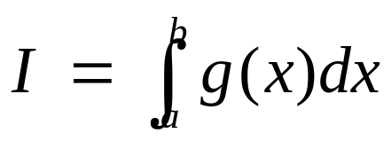
3. Variance reduction: Importance Sampling Method
Importance sampling method
Basic idea
Put more points near maximum
Put less points near minimum
c
f(x)
X的概率密度函数为f(x)
g(x)

Slide 31
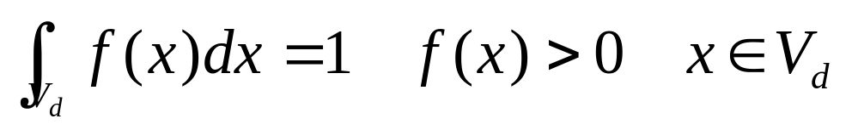
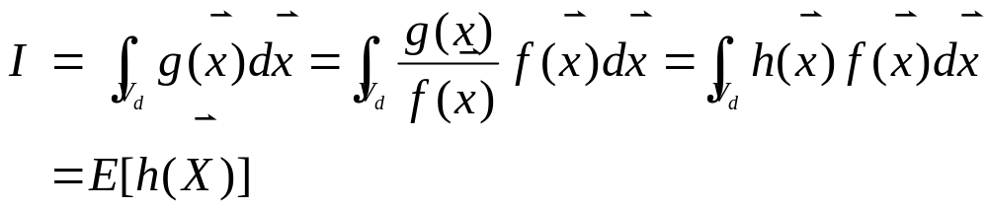
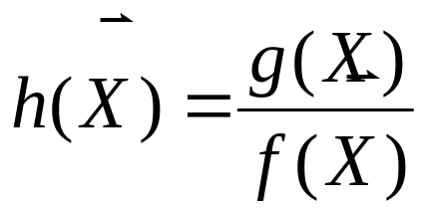
3. Variance reduction: Importance Sampling Method
设欲求的d-重积分为
令f(x)为积分域V_{d}上随机向量X的概率密度函数

Slide 32
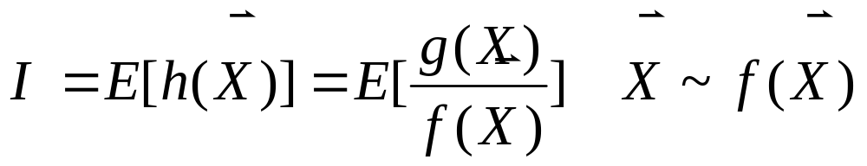
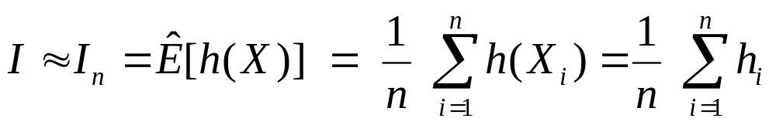
3. Variance reduction: Importance Sampling Method
So, we will estimate I by estimating E[h(X)] with
where X₁, X₂, …, X_{n} is a random sample from the f(X) distribution.

Slide 33
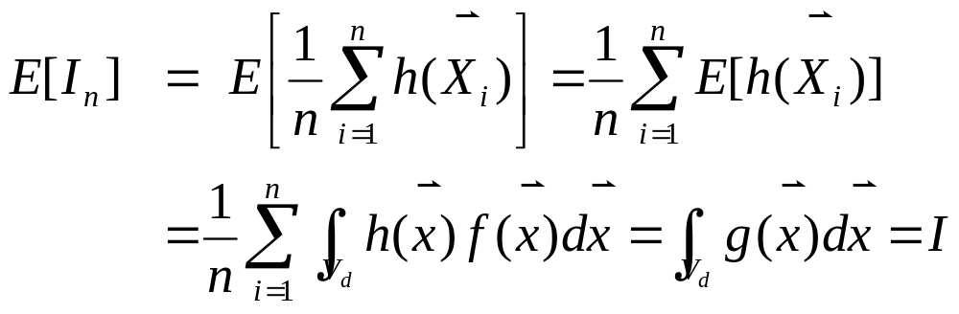
3. Variance reduction:Importance Sample Method
误差分析：
This estimator is “unbiased”:

Slide 34
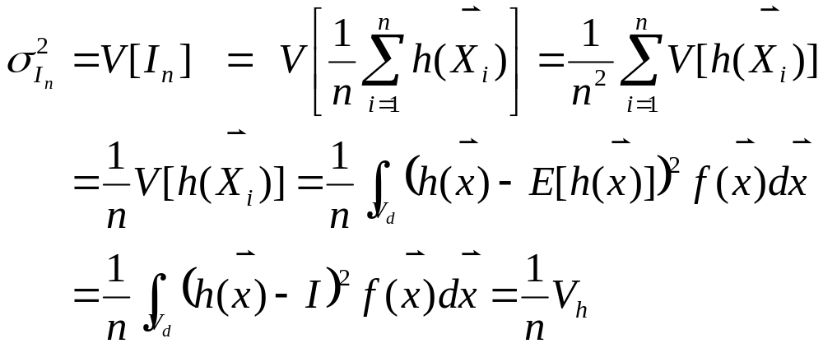
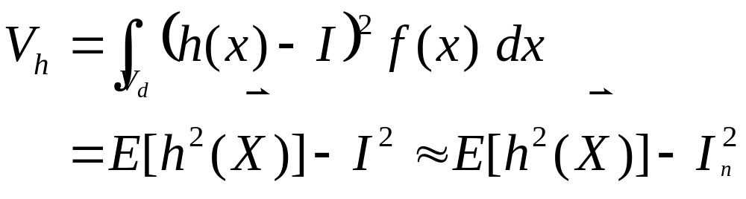
3. Variance reduction:Importance Sample Method
Variance of this estimator:

Slide 35


3. Variance reduction:Importance Sample Method
一维积分的情况：

Slide 36
3. Variance reduction:Importance Sample Method
Start
Set N : large integer
s = 0
Loop
N times
Generate x_{n} according to f(x)
h_{n} = g (x_{n}) / f ( x_{n})
Add h_{n} to s
I =s₁/N
End

Slide 37
Monte Carlo模拟
第四章 Monte Carlo积分
Hit-or-Miss Method
Sample Mean Method
Variance Reduction: Importance Sampling Method
Correlation methods for variance reduction

Slide 38
4. Correlation methods for Variance reduction
Correlation method:
Use correlated points in the sampling to reduce the variance of the integrand and improve the efficiency of the estimation
Control variates
Antithetic variables

Slide 39

4. Correlation methods for Variance reduction
Control variates
f(x): Control variate for g(x), must satisfy:
Simple enough to allow analytical integration
Should mimic g(x) to absorb most of its fluctuation
f(x) ~ g(x)

Slide 40
4. Correlation methods for Variance reduction

Slide 42
第九章 Monte Carlo积分
Hit-or-Miss Method
Sample Mean Method
Variance Reduction Technique
Variance Reduction using Rejection Technique
Importance Sampling Method

Slide 43





Variance Reduction Technique
Introduction
Monte Carlo Method and Sampling Distribution
  Monte Carlo Method : Take values from random sample
  From central limit theorem,
  3σ rule
  Most probable error
Important characteristics

Slide 44


Variance Reduction Technique
Introduction
Reducing error
  *100 samples reduces the error order of 10
  Reducing variance → Variance Reduction Technique
The value of variance is closely related to how samples are taken
  Unbiased sampling
  Biased sampling
    More points are taken in important parts of the population

Slide 45

Variance Reduction Technique
Motivation
If we are using sample-mean Monte Carlo Method
  Variance depends very much on the behavior of ρ(x)
    ρ(x) varies little → variance is small
    ρ(x) = const → variance=0
Evaluation of a integral
  Near minimum points → contribute less to the summation
  Near maximum points → contribute more to the summation
  More points are sampled near the peak →”importance sampling strategy”

Slide 46


2. Sample Mean Method
X₁, X₂, …, X_{n} iid -> g(X₁), g(X₂), …, g(X_{n}) iid
Let Y_{i}=g(X_{i}) for i=1,2,…,n
Then
and we can once again invoke the CLT.

Slide 47




2. Sample Mean Method
For n “large enough” (n>30),
So, a confidence interval for I is roughly given by
but since we don’t know , we’ll have to be content with the further approximation:

Slide 48



2. Sample Mean Method
By the way…
No one ever said that you have to use the uniform distribution
Example:
where X~exp(rate=2).

Slide 49
第九章 Monte Carlo积分
1.2 Hit-or-Miss Method
1.3 Sample Mean Method
2.1 Variance Reduction Technique
2.3 Variance Reduction using Rejection Technique
2.4 Importance Sampling Method

Slide 50




Variance Reduction Technique
Variance Reduction for Hit-or-Miss method
In the domain [a,b] choose a comparison function
w(x)
ρ(x)
X
X
X
X
X
O
O
O
O
O
O
O
a
b
Points are generated on the area under w(x) function
  Random variable that follows distribution w(x)

Slide 51




Variance Reduction Technique
Points lying above ρ(x) is rejected
w(x)
ρ(x)
X
X
X
X
X
O
O
O
O
O
O
O
a
b
q | 1 | 0
P(q) | r | 1-r

Slide 52





Variance Reduction Technique
Error Analysis
Hit or Miss method
Error reduction

Slide 53

Variance Reduction Technique
Start
Set N : large integer
w(x)
ρ(x)
N’ = 0
X
X
X
X
X
O
Loop
N times
Generate u₁, x= W-¹(Au₁)
O
O
O
O
O
O
Generate u₂, y=u₂ w(x)
a
b
If y<= f(x) accept value N’ = N’+1
Else : reject value
I = (b-a) h (N’/N)
End

